Slide 1

Organism-Level Analysis of Vaccination Reveals Networks of Protection across Tissues
Motohiko Kadoki, Ashwini Patil, Cornelius C. Thaiss, Donald J. Brooks, Surya Pandey, Deeksha Deep, David Alvarez, Ulrich H. von Andrian, Amy J. Wagers, Kenta Nakai, Tarjei S. Mikkelsen, Magali Soumillon, Nicolas Chevrier
Cell
Volume 171 Issue 2 Pages 398-413.e21 (October 2017)
DOI: 10.1016/j.cell.2017.08.024
Copyright © 2017 Elsevier Inc. Terms and Conditions

Slide 2
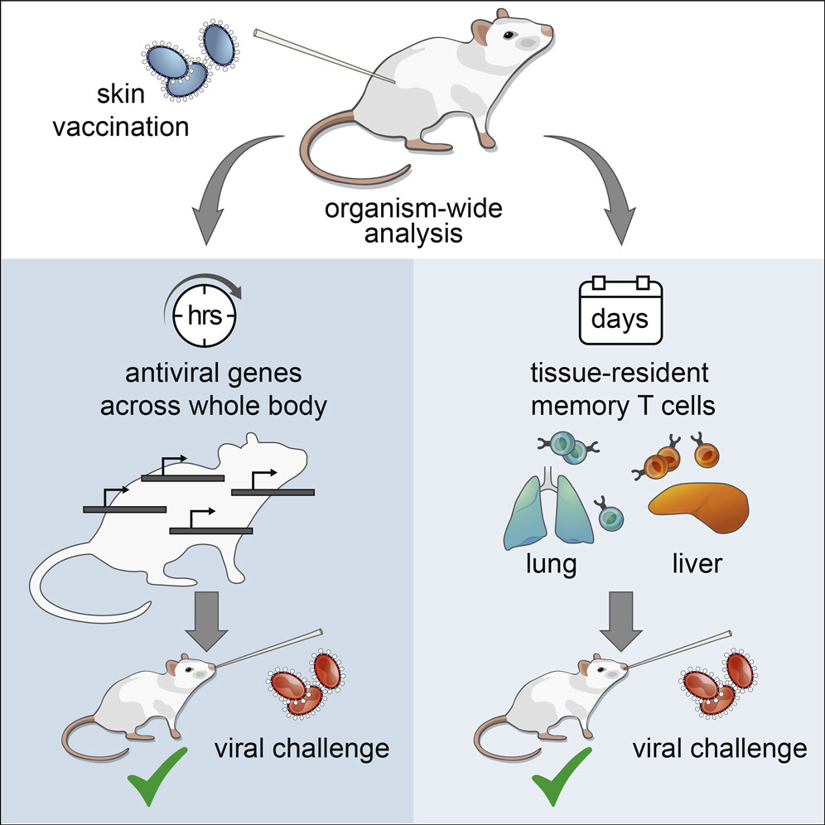
Cell 2017 171398-413.e21DOI: (10.1016/j.cell.2017.08.024)
Copyright © 2017 Elsevier Inc. Terms and Conditions

Slide 3
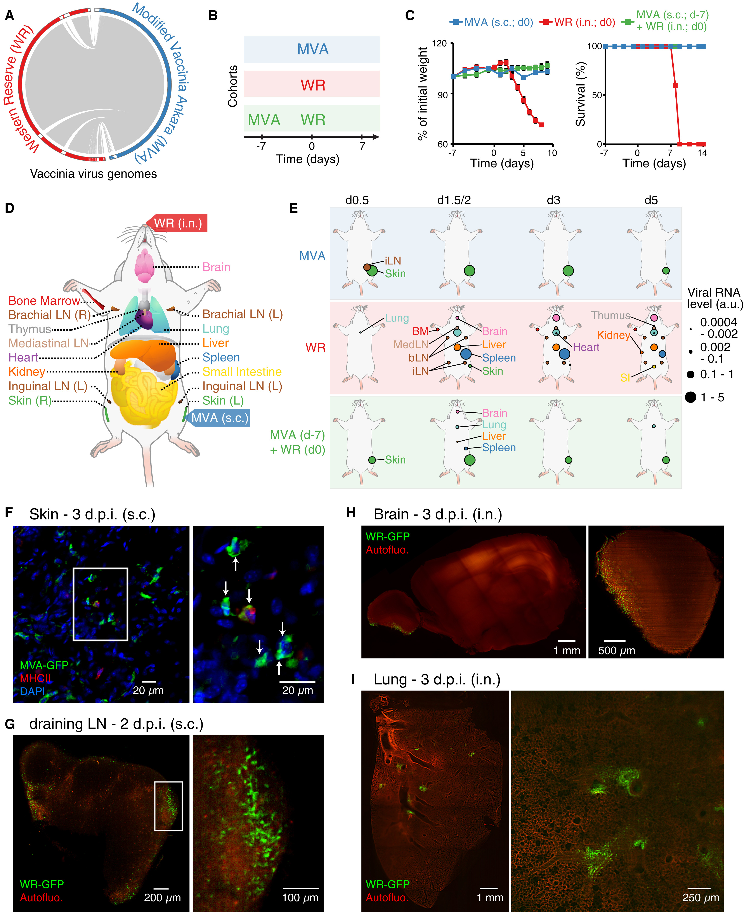
Figure 1
Cell 2017 171398-413.e21DOI: (10.1016/j.cell.2017.08.024)
Copyright © 2017 Elsevier Inc. Terms and Conditions
Notes:
Dynamics of Viral Spread at the Whole-Organism Scale
(A) Viral genome alignment. Gray lines depict shared sequences. White boxes in the outer circle show genomic regions absent in the other strain.
(B and C) Cohorts of mice used to track vaccinating (MVA subcutaneously [s.c.]), lethal (WR intranasally [i.n.]), and protective (MVA followed by WR) responses (B), matching weight (C, left), and survival (C, right) measurements. Error bars, SEM (n = 5).
(D) Schematic depicting the mouse tissues collected in this study (17 total including blood, which is not shown).
(E) Organismal viral spread for indicated cohorts (left) and times post-infection (top). Circle sizes (right), normalized expression for viral gene E3L (encoded by MVA and WR).
(F–I) Whole-mount tissue imaging of skin (F), draining lymph node (inguinal; G), brain (H), and lung (I) at 2 or 3 day post-infection (d.p.i.) using indicated GFP-expressing virus strains and routes of infection. For skin (F) and dLN (G), insets indicate position of images on the right. For skin (F), MHC class II and nuclei (DAPI) were stained, and arrows indicate MVA-GFP⁺ cells. For brain (H) and lung (I), tiled images (left) and representative sections (right) are shown. Autofluo., autofluorescence.
See also Figure S1 and Table S1.

Slide 4
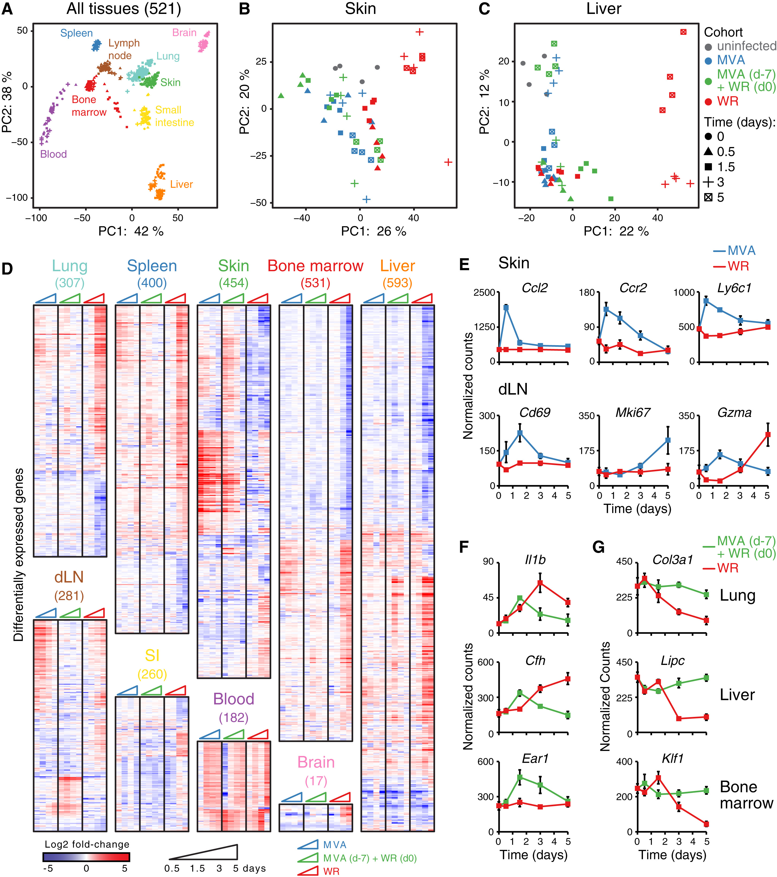
Figure 2
Cell 2017 171398-413.e21DOI: (10.1016/j.cell.2017.08.024)
Copyright © 2017 Elsevier Inc. Terms and Conditions
Notes:
Whole-Tissue Gene Expression Reveals Local and Systemic Immune Responses
(A–C) Principal component analysis (PCA) of whole-tissue mRNA profiles for 9 tissues (521 samples; A), skin (B), and liver (C). Colors, tissues (A) or cohorts (B and C); symbols, time after infection; axes, percentage of variance; lymph node, inguinal draining LN.
(D) Heatmaps of differentially expressed genes (numbers in parentheses on top) from whole-tissue mRNA profiles ordered by hierarchical clustering (Pearson’s correlation) and tissue type. Shown are log2 fold-change values relative to matching, uninfected tissues (FDR-adjusted p value < 0.05, absolute fold change > 2, n = 4).
(E–G) Normalized read counts for indicated genes, cohorts, and tissues. Error bars, SEM (n = 4).
See also Figure S2 and Table S2.

Slide 5
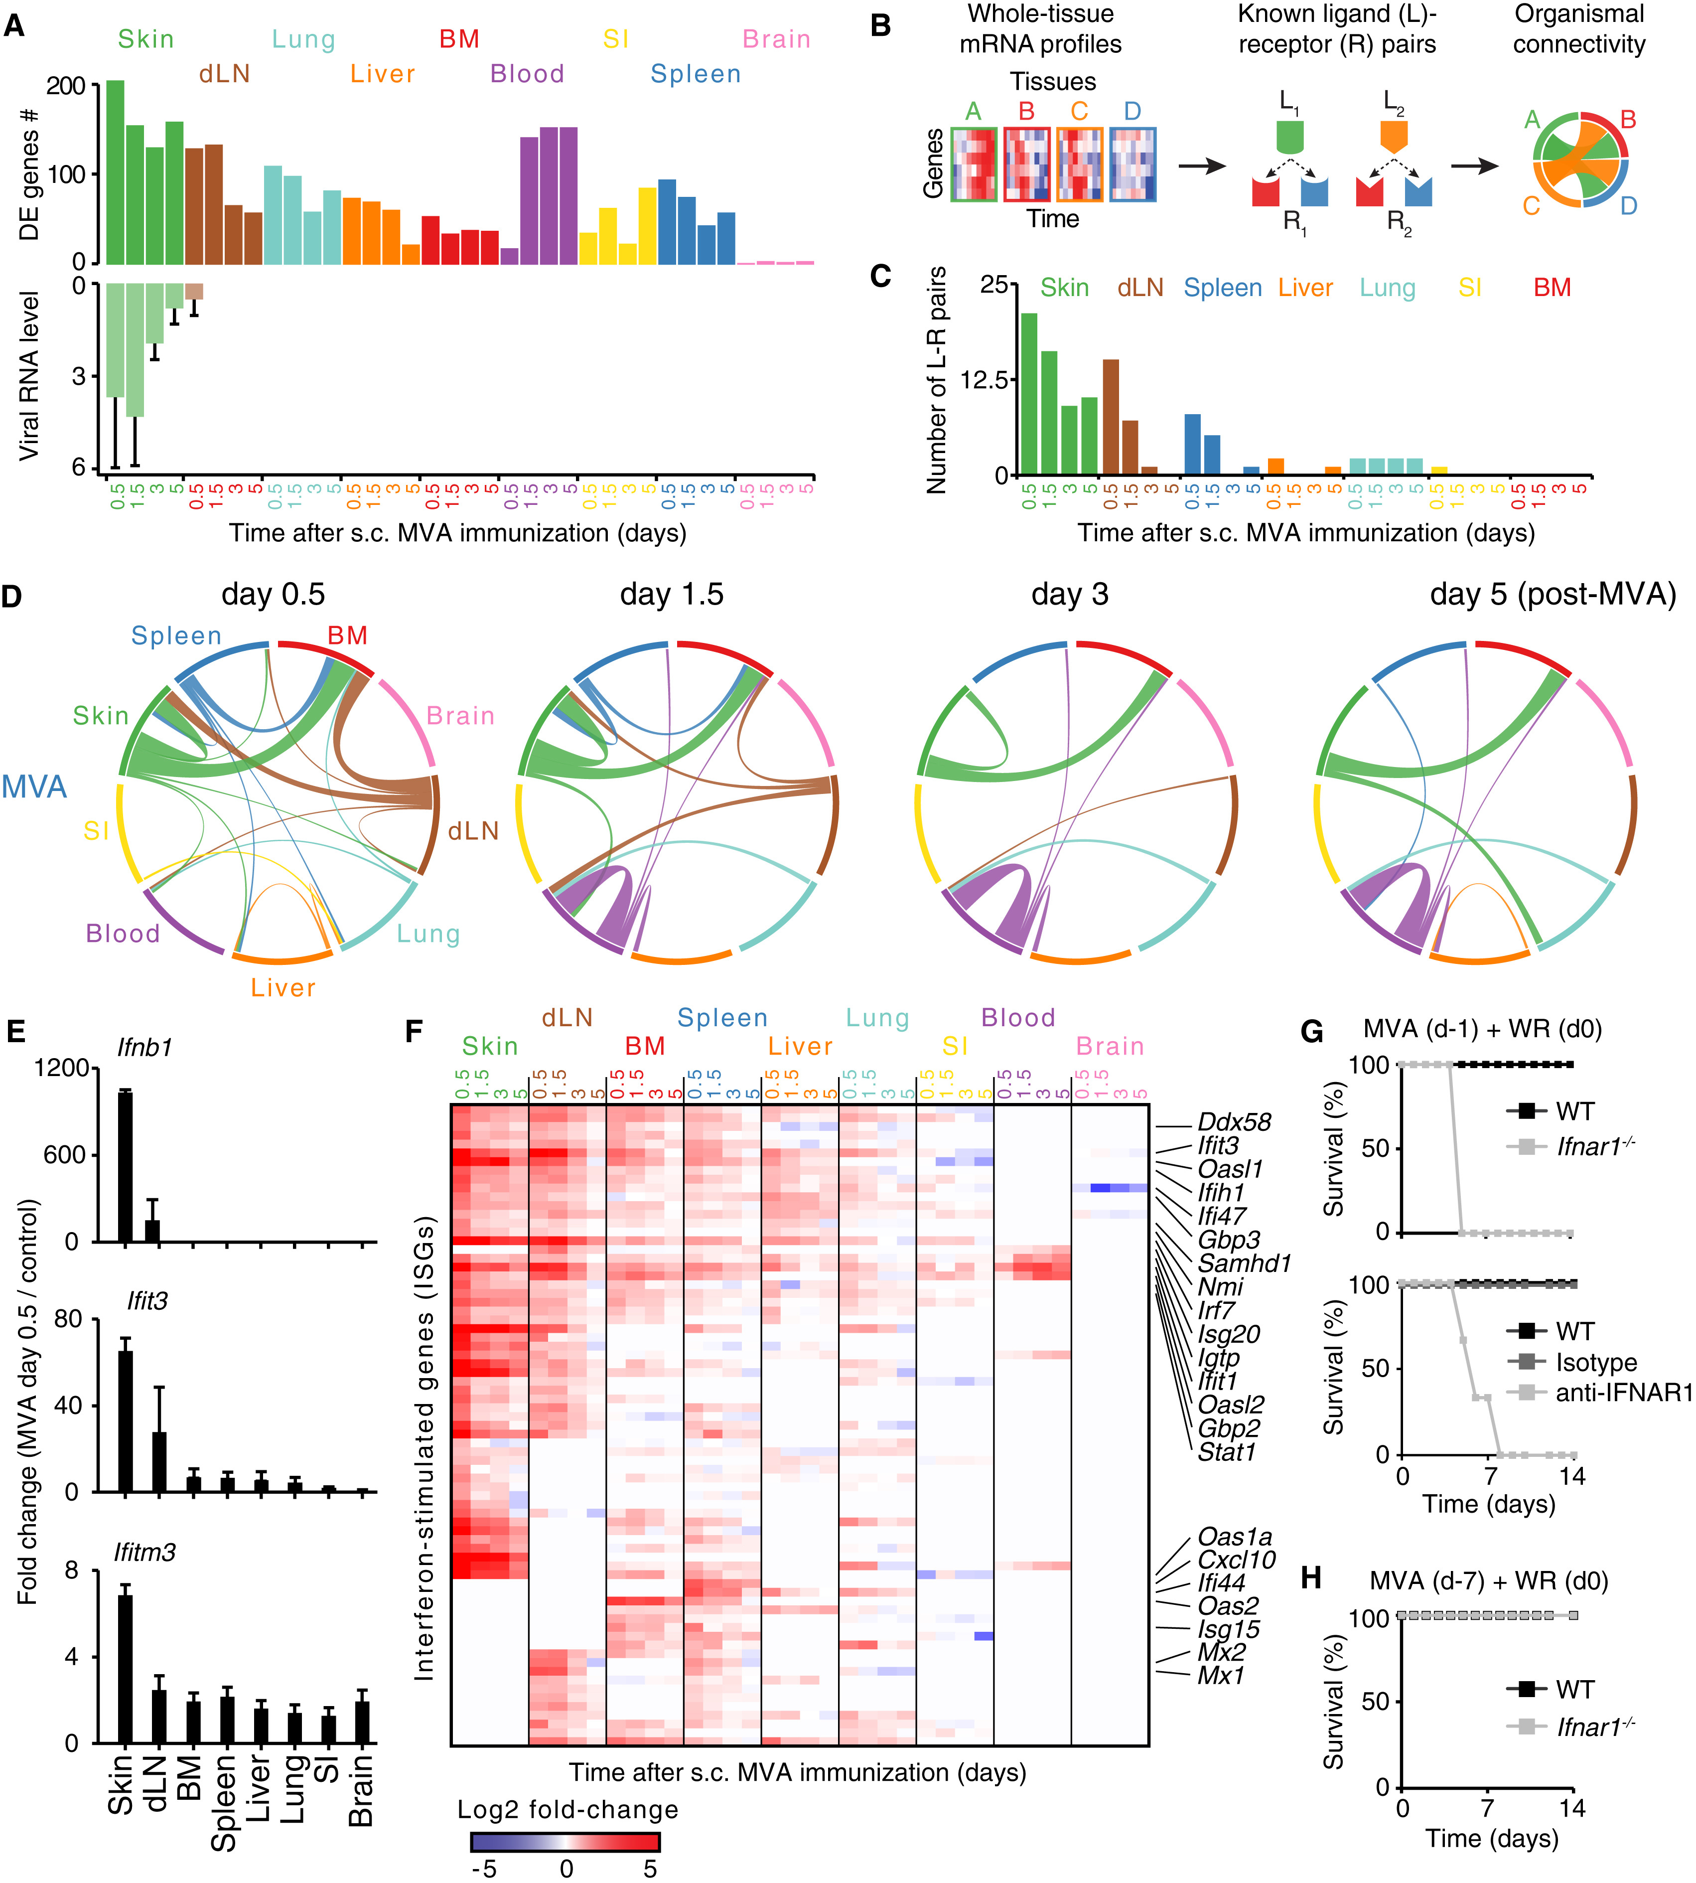
Figure 3
Cell 2017 171398-413.e21DOI: (10.1016/j.cell.2017.08.024)
Copyright © 2017 Elsevier Inc. Terms and Conditions
Notes:
Analysis of Ligand-Receptor Connectivity across Tissues Reveals a Whole-Body Antiviral State
(A) Bar graphs show numbers of differentially expressed (DE) genes (top) and RNA levels of Vaccinia virus gene E3L (qPCR; bottom). Error bars, SD.
(B) Schematic overview of the analysis for ligand-receptor pair connectivity across tissues. Known ligand-receptor pairs were extracted from whole-tissue mRNA profiles and their potential links within and between tissues visualized using a circos plot.
(C) Bar graph shows the numbers of ligand (L)-receptor (R) pairs emanating from indicated tissues following MVA immunization (s.c., subcutaneous).
(D) Inter-organ connectivity of ligand-receptor pairs at indicated times after MVA immunization. Line color, tissue source for ligands; line thickness, number of ligand-receptor pairs.
(E) Bar graphs show fold changes between MVA-infected and control tissues for Ifnb1 and two ISGs: Ifit3 and Ifitm3 (qPCR). Error bars, SD (n = 4).
(F) Heatmap of all interferon-stimulated genes (ISGs) regulated across tissues following skin MVA vaccination. Shown are log2 fold-change values relative to matching, uninfected tissues (FDR-adjusted p value < 0.05 and absolute fold change > 2, n = 4).
(G and H) Survival analysis of wild-type (WT), anti-IFNAR1 or isotype antibody-treated, and Ifnar1^{−/−} mice immunized subcutaneously with MVA at 1 (G) or 7 (H) days prior to intranasal WR challenge. Data are representative of three independent experiments.
See also Figure S3 and Table S3.

Slide 6
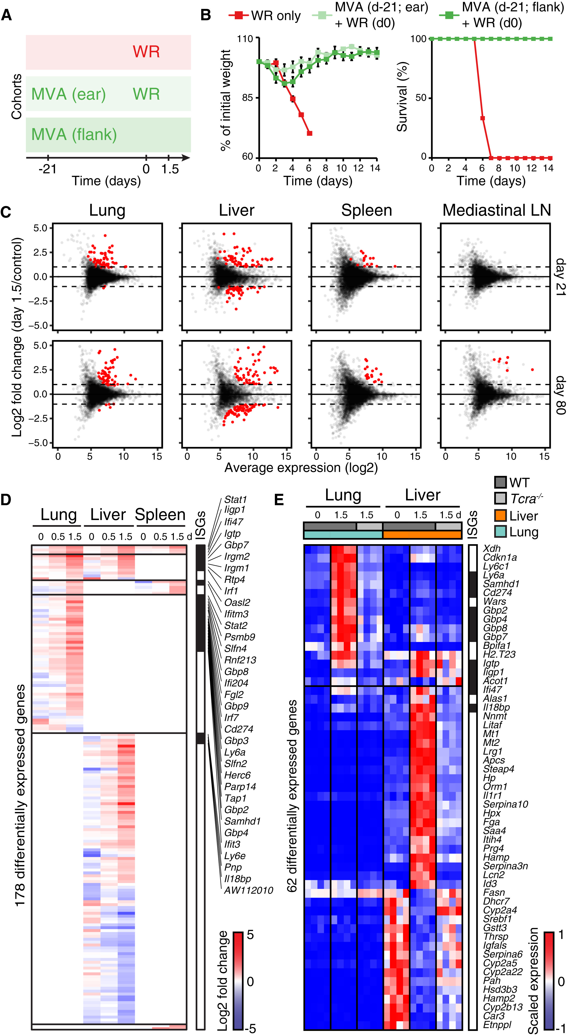
Figure 4
Cell 2017 171398-413.e21DOI: (10.1016/j.cell.2017.08.024)
Copyright © 2017 Elsevier Inc. Terms and Conditions
Notes:
Protective Memory Responses to a Respiratory Viral Challenge Induce Expression Changes in Lung, Liver, and Spleen
(A and B) Cohorts of mice used to track memory protective responses using MVA immunization at skin (ear or flank), followed by intranasal WR challenge at day 21 (A), and matching weight and survival measurements (B). Error bars, SEM (n = 4).
(C) Dot plots show log2 fold change in gene expression (y axis) in tissues collected at 1.5 day post-WR challenge (on day 21 or 80 after MVA) relative to uninfected controls against log2 average expression (x axis) (n = 4). Red dots, genes with FDR < 0.05 and absolute log2 fold change > 1.
(D and E) Heatmaps show differentially expressed genes in lung, liver, and spleen at indicated days (d) after intranasal WR challenge of wild-type (D and E) and/or Tcra^{−/−} (E) mice immunized with MVA at flank skin 21 days earlier (FDR-adjusted p value < 0.05 and absolute fold change > 2, n = 4). Shown are log2 fold-change values relative to matching, uninfected tissues (D), and normalized read counts scaled per row (4 replicates/condition) (E). Day 0, mice immunized only. Interferon-stimulated genes (ISGs) are indicated in black on the right.
See also Figure S4 and Table S4.

Slide 7
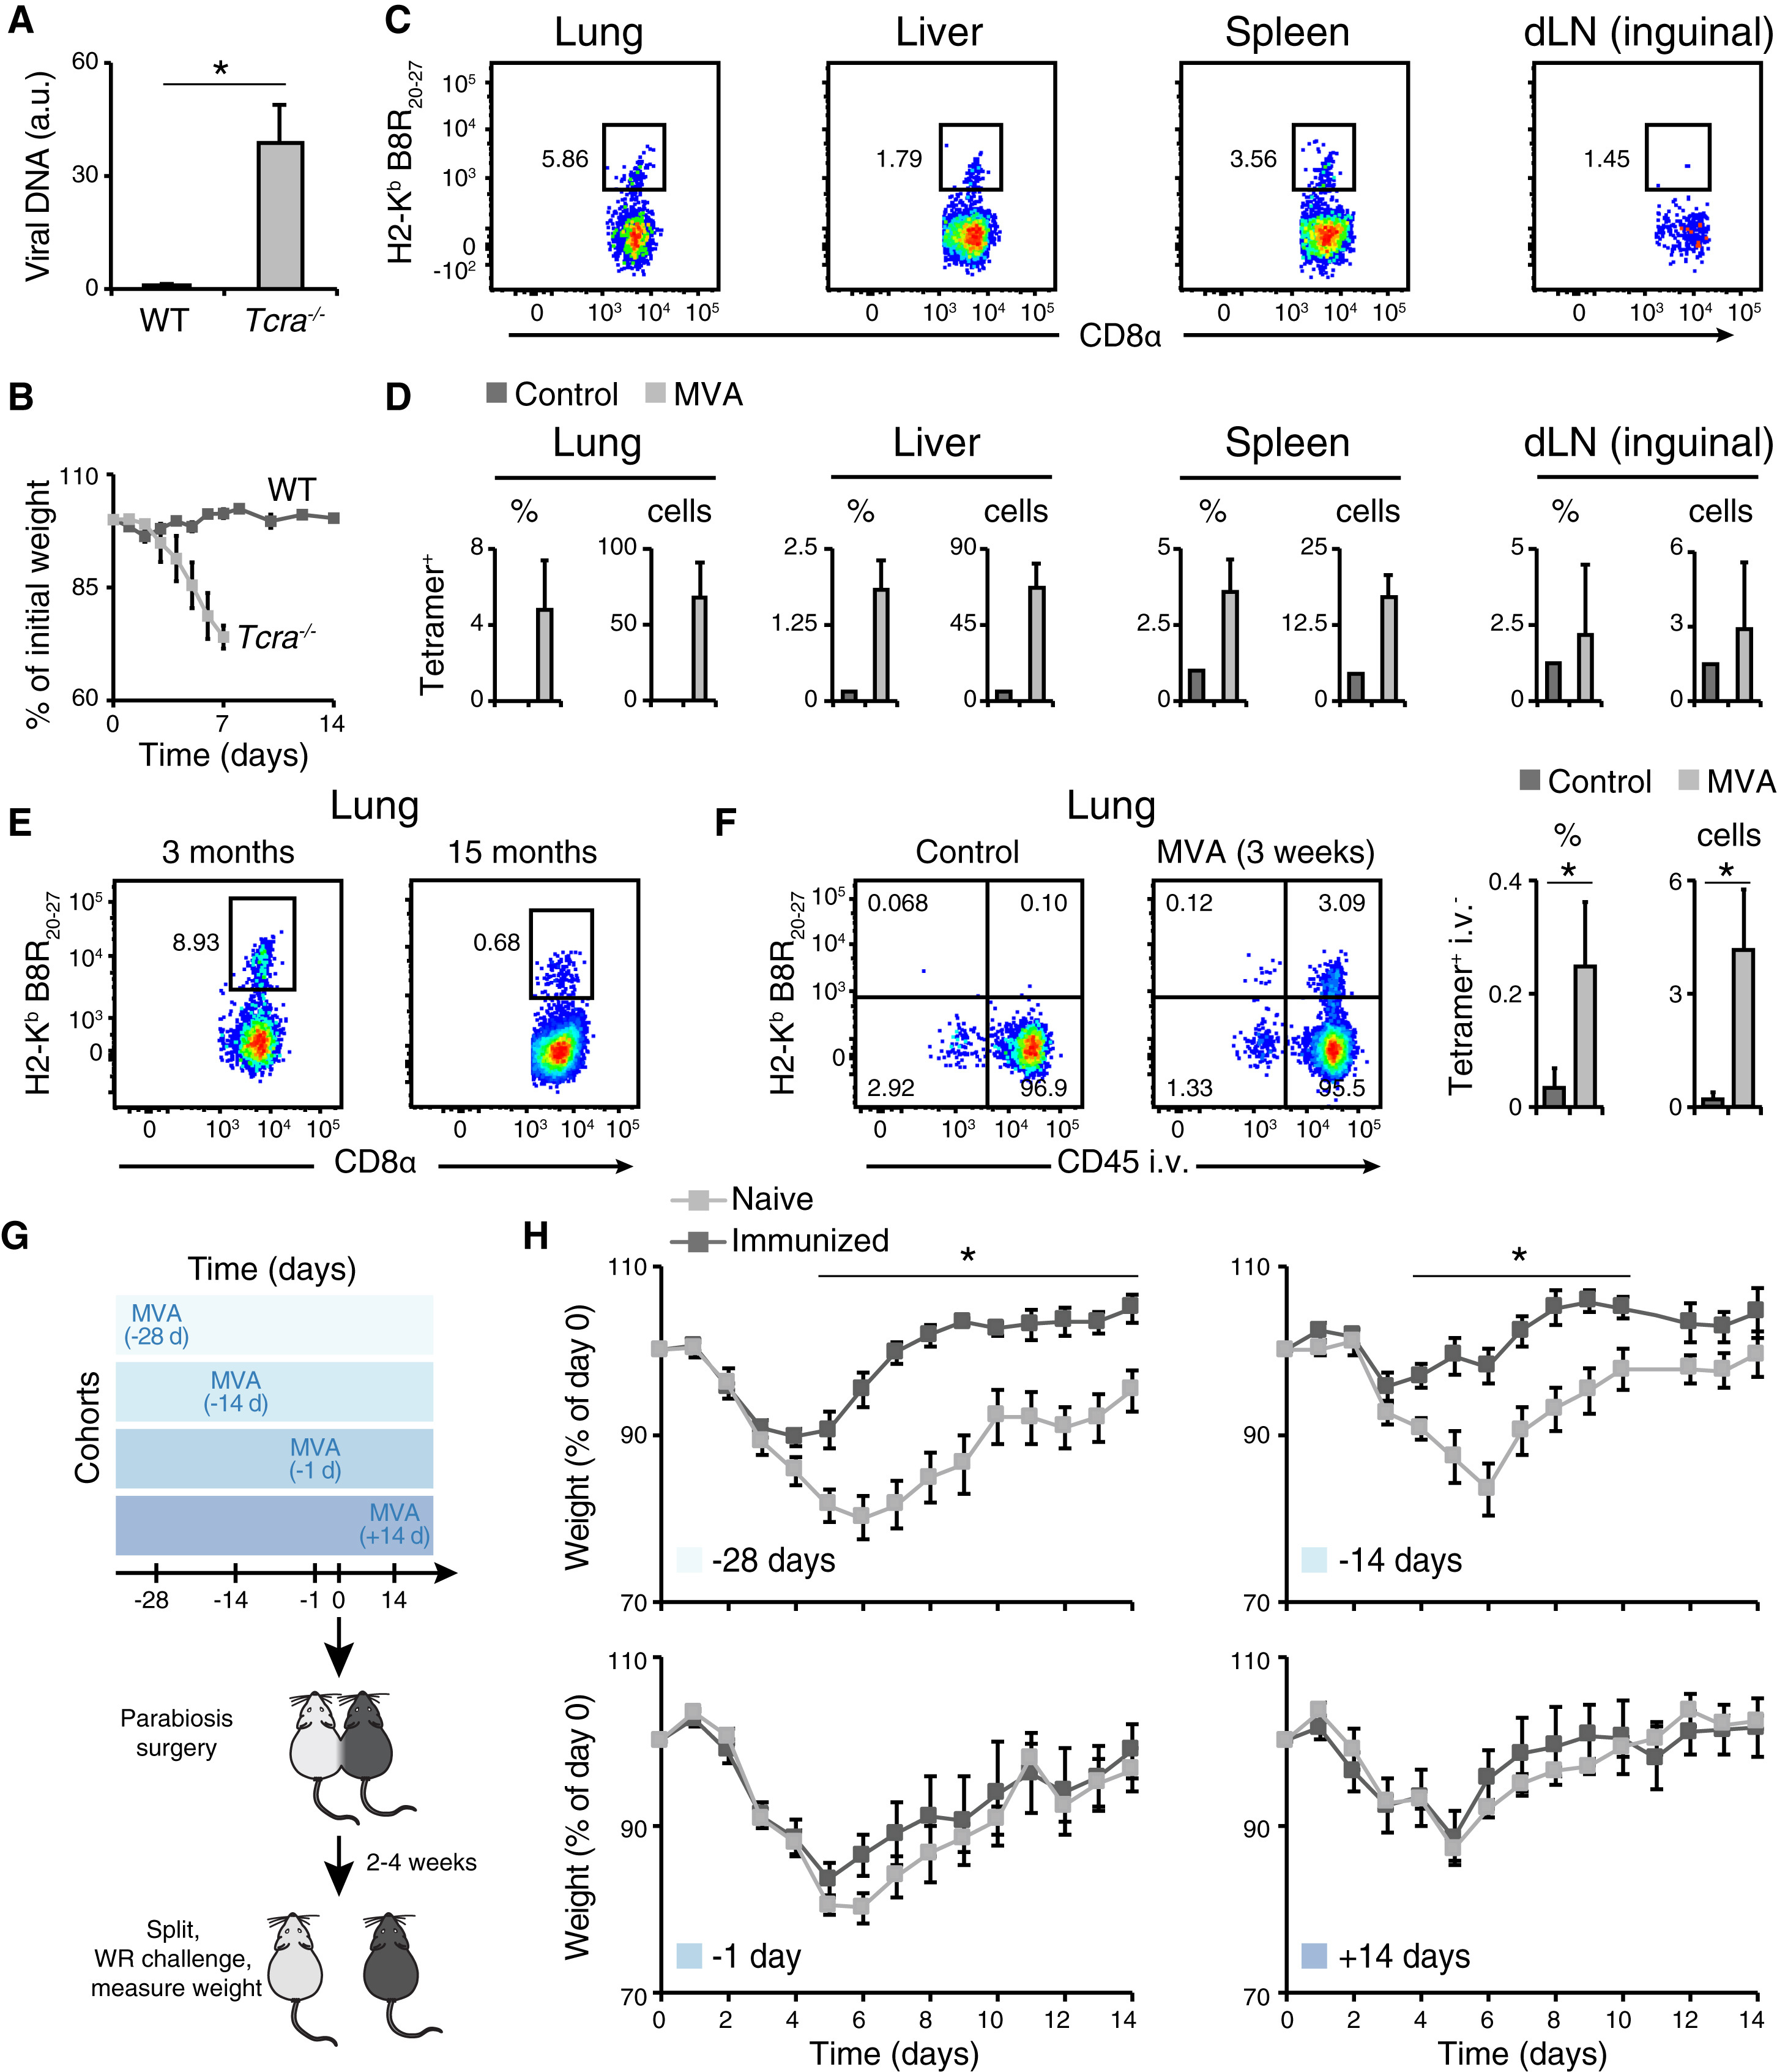
Figure 5
Cell 2017 171398-413.e21DOI: (10.1016/j.cell.2017.08.024)
Copyright © 2017 Elsevier Inc. Terms and Conditions
Notes:
Skin Vaccination Seeds Tissue-Resident Memory CD8⁺ T cells in Multiple Distant Tissues to Confer Host Protection
(A and B) Relative viral DNA amount measured by qPCR in the brain (day 2 post-WR) (A) and weight measurements (B) of wild-type (WT) and T cell deficient (Tcra^{−/−}) mice immunized subcutaneously with MVA 3 weeks prior to intranasal WR challenge. a.u., arbitrary units (WT values set to 1) (A). Error bars, SD (n = 5) in (A), and SEM (n = 7) in (B). ∗p < 0.05, Student’s t test.
(C–E) Flow cytometry analysis of Vaccinia virus peptide B8R-specific (H2-K^{b} B8R20–27) memory CD8α⁺ T cells (gated on live CD3ε⁺CD44⁺CD62L⁻ cells) from indicated tissues from mice vaccinated at skin with MVA 3 weeks (C), 3 months (E, left), or 15 months (E, right) earlier, and quantifications in percentage of parent gate (%) and absolute count per 10⁵ live cells (cells) (D). Error bars, SD (n = 5).
(F) Flow cytometry analysis of vascular and parenchymal B8R-specific memory CD8α⁺ T cells (gated on live CD3ε⁺CD44⁺CD62L⁻ cells) by intravascular staining with CD45 (CD45 intravenously [i.v.]). Bar graphs show quantifications in percentage of parent gate (%) and absolute count per 10⁵ live cells (cells). Error bars, SD (n = 3). ∗p < 0.05, Student’s t test.
(G and H) Timed parabiosis experiments show the role of tissue-resident cells in host protection. One parabiont (CD45.2) was immunized at skin with MVA at indicated days before (−28, −14, and −1) or after (+14) joining with the other parabiont (CD45.1) (G). For groups −28, −14, and −1, mice were joined for 2 weeks before splitting, whereas for group +14, mice were joined for 2 weeks before immunization of one parabiont and split after another 2 weeks. Weight measurements of immunized (dark gray) and naive (light gray) parabionts after WR challenge are shown in (H). Data are representative of two to three independent experiments. Error bars, SEM (n = 5). ∗p < 0.05, Student’s t test.
See also Figure S5.

Slide 8
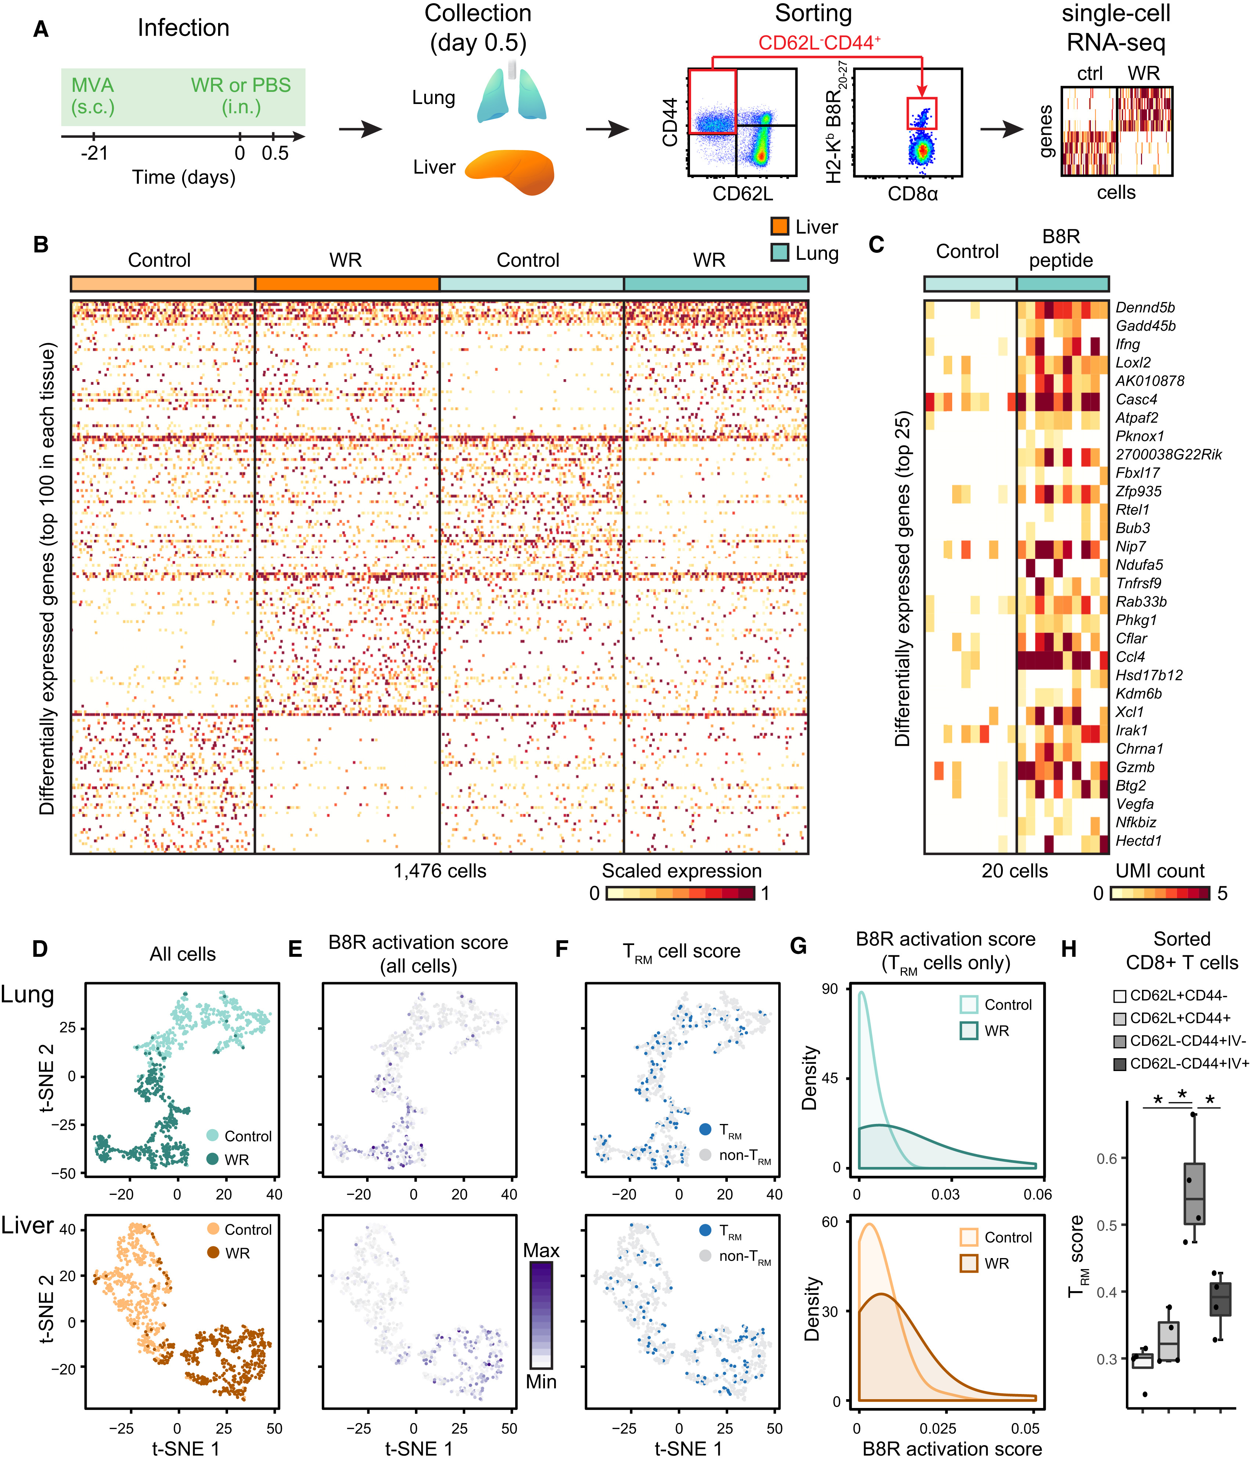
Figure 6
Cell 2017 171398-413.e21DOI: (10.1016/j.cell.2017.08.024)
Copyright © 2017 Elsevier Inc. Terms and Conditions
Notes:
Tissue-Resident Memory CD8⁺ T Cells Are Activated in Lung and Liver as Virus Spreads
(A) Experimental workflow: mice were immunized with MVA at skin 21 days prior to intranasal WR challenge (or PBS as control) for 0.5 day, and single-lung and liver memory CD8⁺ T cells (live CD3ε⁺CD44⁺CD62L⁻ cells), including virus-specific cells were sorted by fluorescence-activated cell sorting (FACS) prior to single-cell (sc) RNA-seq.
(B) Heatmap of 1,476 single-memory CD8⁺ T cells (columns) from lung and liver showing the top 100 differentially expressed genes (rows) between control (PBS only) and WR-challenged mice in each tissue type (FDR < 0.01, expression fold change > 3).
(C) Heatmap of 20 single virus-specific (H2-K^{b} B8R20–27) CD8⁺ T cells (columns) showing the top 25 differentially expressed genes (rows) between cells from lungs of mice challenged with B8R20–27 peptide (20 μg) or saline as control (FDR < 0.01, expression fold change > 3). UMI, unique molecular identifiers.
(D and E) Impact of WR challenge on single CD8⁺ memory T cell states. Visualization of single cells from lung (top) and liver (bottom) from control (MVA vaccination only) and WR-challenged mice using t-distributed stochastic neighbor embedding (t-SNE) (D). t-SNE plots from (D) are shown in (E) and colored based on the B8R activation score (scaled average expression of genes differentially expressed in both WR (B) and peptide B8R20–27 (C) challenges).
(F and G) Tissue-resident memory CD8⁺ T cells (TRM) are activated in both lung and liver following intranasal WR challenge. t-SNE plots from (D) are shown in (F) and colored based on the TRM cell score (scaled average expression of genes associated with the TRM phenotype). Blue dots indicate a TRM score > mean TRM score of all cells +1 SD. In (G), the distributions of B8R activation scores (E) in TRM cells (F) are shown.
(H) TRM scores for indicated CD8⁺ T cell populations sorted from lung after intravascular (IV) immunostaining. Error bars, SD (n = 4). ∗p < 0.05, Student’s t test.
See also Figure S6 and Table S5.

Slide 9
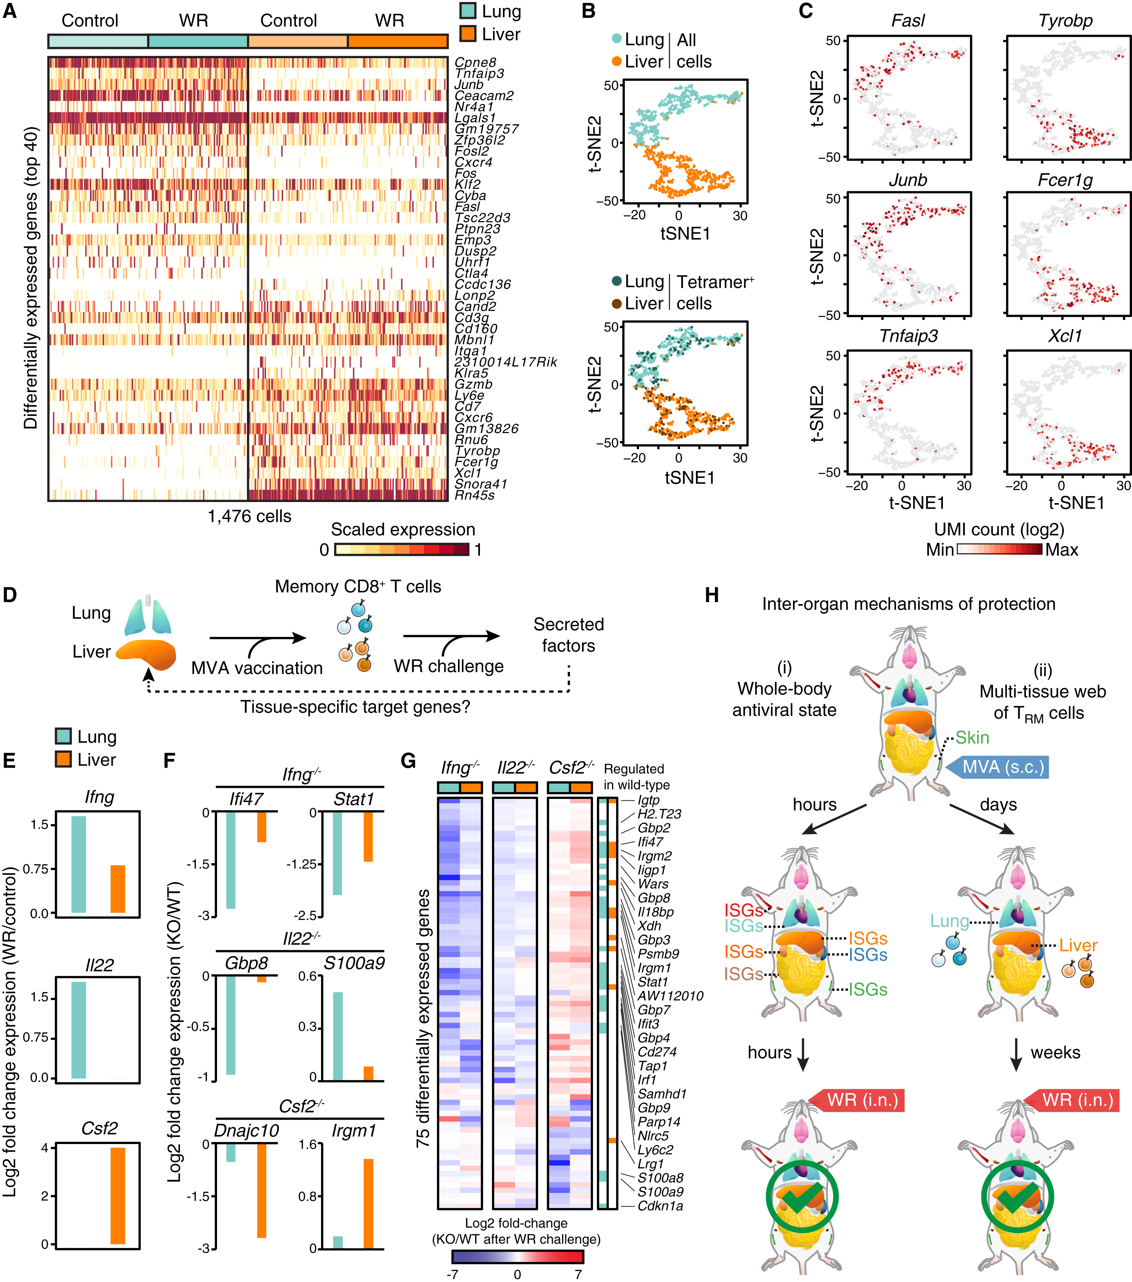
Figure 7
Cell 2017 171398-413.e21DOI: (10.1016/j.cell.2017.08.024)
Copyright © 2017 Elsevier Inc. Terms and Conditions
Notes:
Local Tissue Environments Shape the Functional Abilities of Memory CD8⁺ T Cells to Bolster Organ-Specific Responses
(A) Heatmap of 1,476 single-memory CD8⁺ T cells (columns) showing the top 40 differentially expressed genes (rows) between lung and liver of control (MVA vaccination only) and WR-challenged mice (FDR < 0.01, expression fold change > 3).
(B) Visualization of single cells from lung and liver in MVA-vaccinated mice (control) using t-SNE. Vaccinia virus peptide B8R-specific (H2-K^{b} B8R20–27) CD8⁺ T cells (Tetramer⁺) are labeled in the bottom plot for lung (25.4%, 94/370 cells) and liver (25.3%, 93/368 cells).
(C) Expression levels of tissue-specific genes in single cells. t-SNE plot from (B) colored based on expression levels (UMI, unique molecular identifiers) of indicated genes.
(D) Illustration of the impact of tissue-adapted memory CD8⁺ T cells on their respective tissue of residence. From left to right, vaccination at skin seeds memory CD8⁺ T cells in lung and liver, which secrete factors controlling tissue responses following WR challenge.
(E) Secreted factor induction in lung and liver at day 0.5 after WR challenge of MVA-vaccinated mice. Fold change values were calculated using single-cell RNA-seq profiles from WR-challenged versus vaccinated only mice as control.
(F and G) Tissue-level expression changes for target genes of secreted factors produced in memory CD8⁺ T cells. Mice were immunized at skin with MVA and challenged 3 weeks later with WR intranasally for 1.5 days. Shown are log2 fold-change values of knockout (KO) relative to wild-type (WT) mice for selected (F) and all differentially expressed genes (G) (FDR-adjusted p value < 0.05, absolute fold change > 2, n = 4).
(H) Schematic depicting the inter-organ mechanisms of protection reported in this study. Following skin MVA vaccination, type I IFNs produced locally trigger a whole-body antiviral state within hours (i; left), and tissue-resident memory CD8⁺ T cells (TRM) seeded in distant tissues help block viral spread (ii; right).
See also Figure S7 and Table S6.

Slide 10
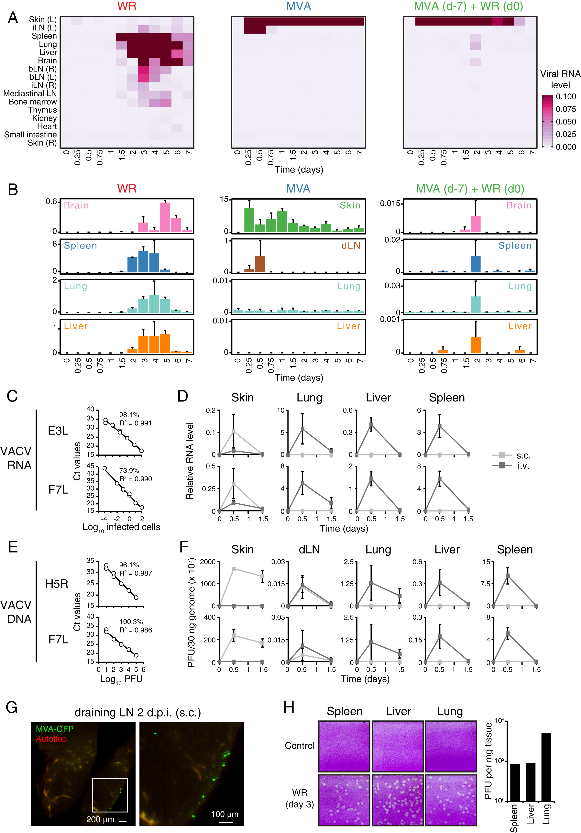
Figure S1
Cell 2017 171398-413.e21DOI: (10.1016/j.cell.2017.08.024)
Copyright © 2017 Elsevier Inc. Terms and Conditions
Notes:
Whole-Organism Scale Analysis of Vaccinia Virus Spread, Related to Figure 1
(A) Heatmap showing average transcript abundance for the viral gene E3L (present in both MVA and WR genomes) as measured by qPCR in indicated tissues (n = 2-4).
(B) Bar graph representation of data from (A) for brain, spleen, lung, liver, skin and draining LN (inguinal; dLN). Error bars, SD.
(C–F) Quantification of Vaccinia virus MVA RNA (C-D) and DNA (E-F) in indicated tissues after subcutaneous (s.c.: light gray) or intravenous (i.v.: dark gray) infection with 10⁷ PFUs/mouse. qPCR measurements were performed on viral genomic DNA (H5R and F7L genes) and mRNA (E3L and F7L genes). Standard curves for each primer pair are shown for known quantities of MVA-infected cells (C) and MVA DNA (E), with PCR efficiency and correlation coefficients indicated on each plot. Error bars, SD.
(G) Whole-mount tissue imaging of draining lymph node (inguinal) at 2 days post-infection (d.p.i.) with GFP-expressing MVA administered subcutaneously (s.c.). Inset indicates position of the image on the right. Autofluo., autofluorescence.
(H) Plaque assay images from whole-tissue homogenates (left), and quantification plot (right).

Slide 11
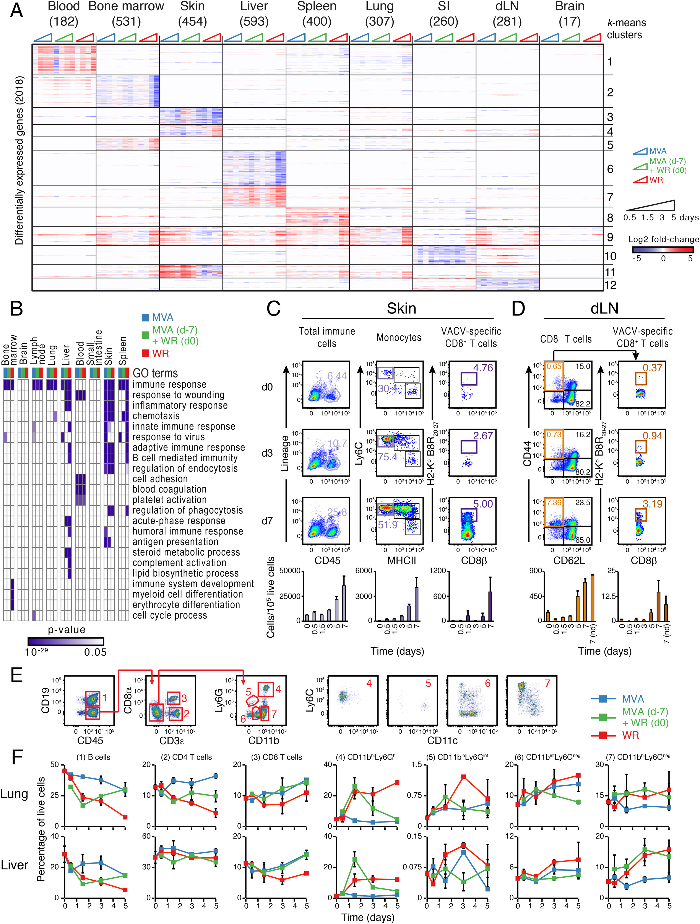
Figure S2
Cell 2017 171398-413.e21DOI: (10.1016/j.cell.2017.08.024)
Copyright © 2017 Elsevier Inc. Terms and Conditions
Notes:
Whole-Tissue RNA-Seq Correlates with Immune Cell Quantifications across Tissues, Related to Figure 2
(A) Heatmap showing all 2,018 differentially expressed genes from Figure 2D, and ordered by k-means clustering (k = 12). Values represent log2 fold change relative to matching, uninfected tissues (FDR-adjusted p value < 0.05, absolute fold change > 2, n = 4).
(B) Heatmap visualization of gene enrichment analyses for all differentially expressed genes in each tissue type and cohort (combined across all 4 time points). Shown are enrichment p values for indicated Gene Ontology (GO) terms (rows) (FDR-adjusted p value < 0.05).
(C–F) Flow cytometry analysis of indicated immune cell subsets in skin (C) and dLN (inguinal; D) upon subcutaneous MVA infection, and in lung and liver for all three cohorts (E-F). For panels C and D, numbers in dot plots indicate percentages relative to parent gate, and bar graphs at the bottom show absolute cell counts per 10⁵ live cells (nd; non-draining LN). For panel F, line graphs show percentages in live cells, corresponding to the composition in whole tissues. VACV, Vaccinia virus. Error bars, SD (n = 2–3).

Slide 12
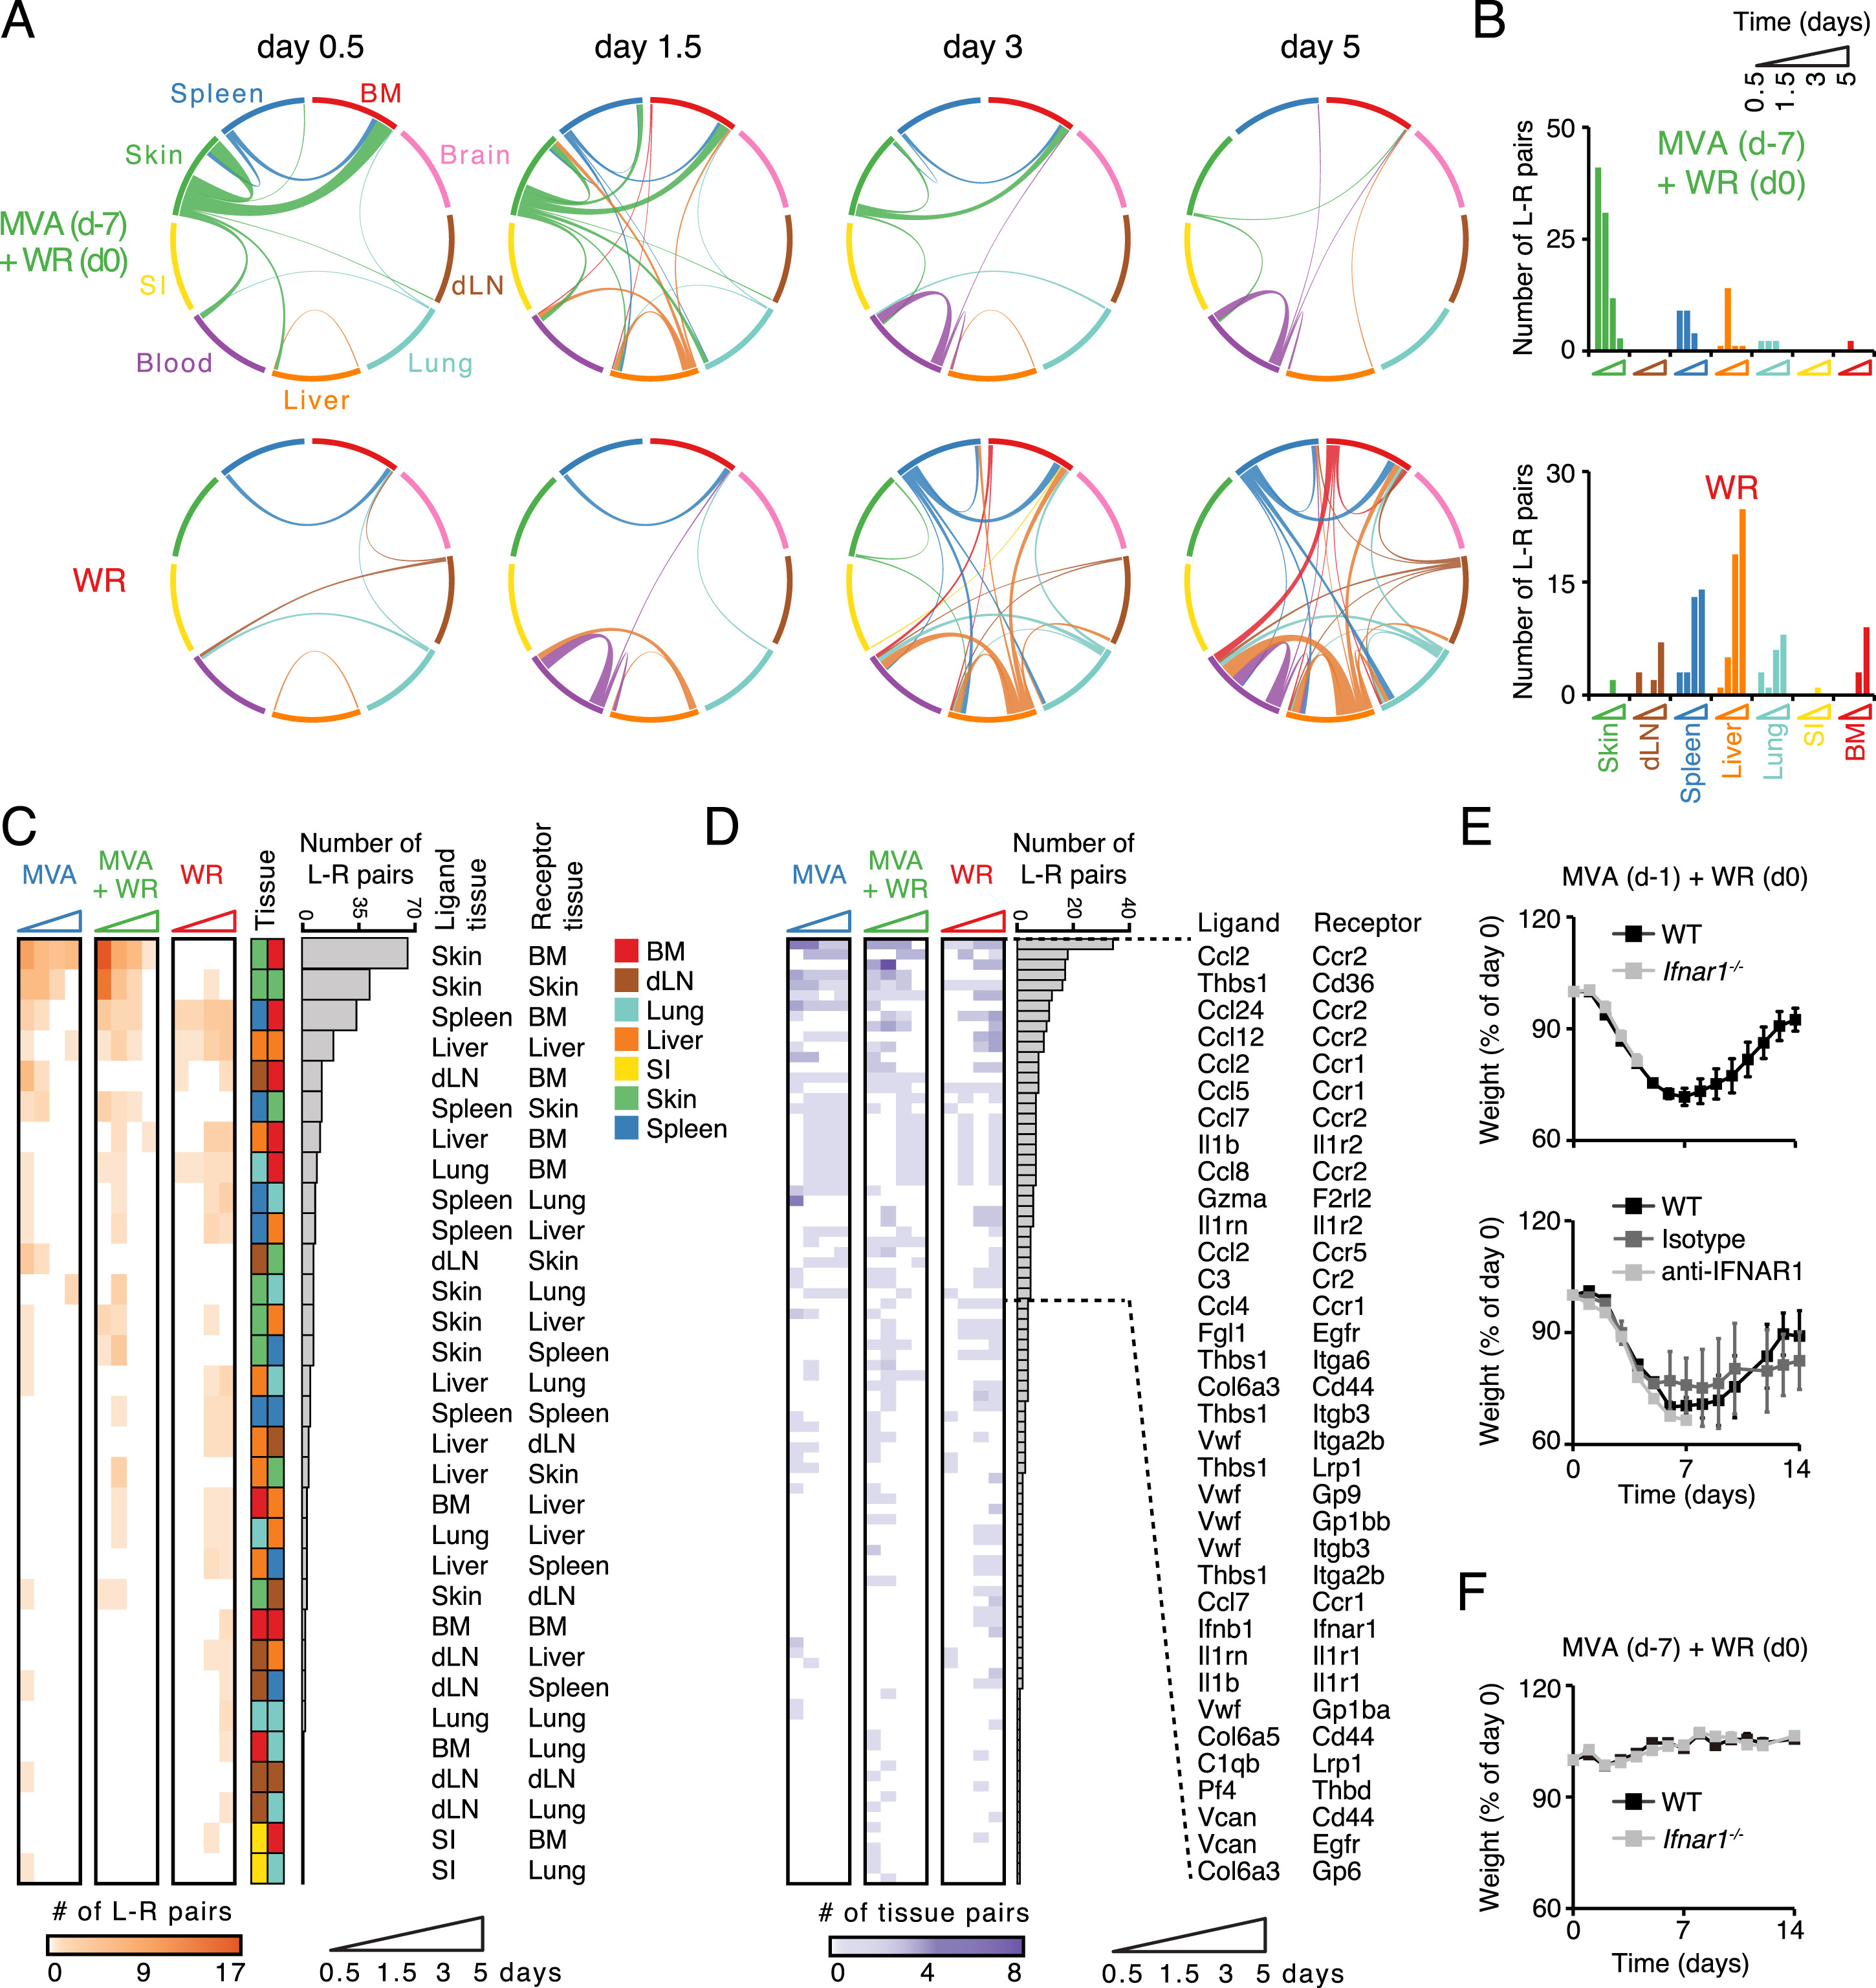
Figure S3
Cell 2017 171398-413.e21DOI: (10.1016/j.cell.2017.08.024)
Copyright © 2017 Elsevier Inc. Terms and Conditions
Notes:
Ligand-Receptor Connectivity across Tissues upon Lethal and Protective Responses, Related to Figure 3
(A) Inter-organ connectivity of ligand-receptor pairs upon skin vaccination shown as circos plots for indicated times. Line color and thickness reflect the tissue source for upregulated ligands and the number of ligand-receptor (L-R) pairs, respectively.
(B) Bar graphs showing the numbers of L-R pairs emanating from indicated tissues in the MVA + WR (top) or WR (bottom) cohorts.
(C and D) Heatmaps showing the number of L-R pairs found for indicated tissue pairs (C), and the number of occurrences for indicated L-R pairs (D) across all times and cohorts.
(E and F) Weight measurements of wild-type (WT), anti-IFNAR1 or isotype antibody-treated, and Ifnar1^{−/−} mice immunized subcutaneously with MVA at 1 (E) or 7 (F) days prior to intranasal challenge with WR. Error bars, SEM (n = 4). Data are representative of three independent experiments.

Slide 13
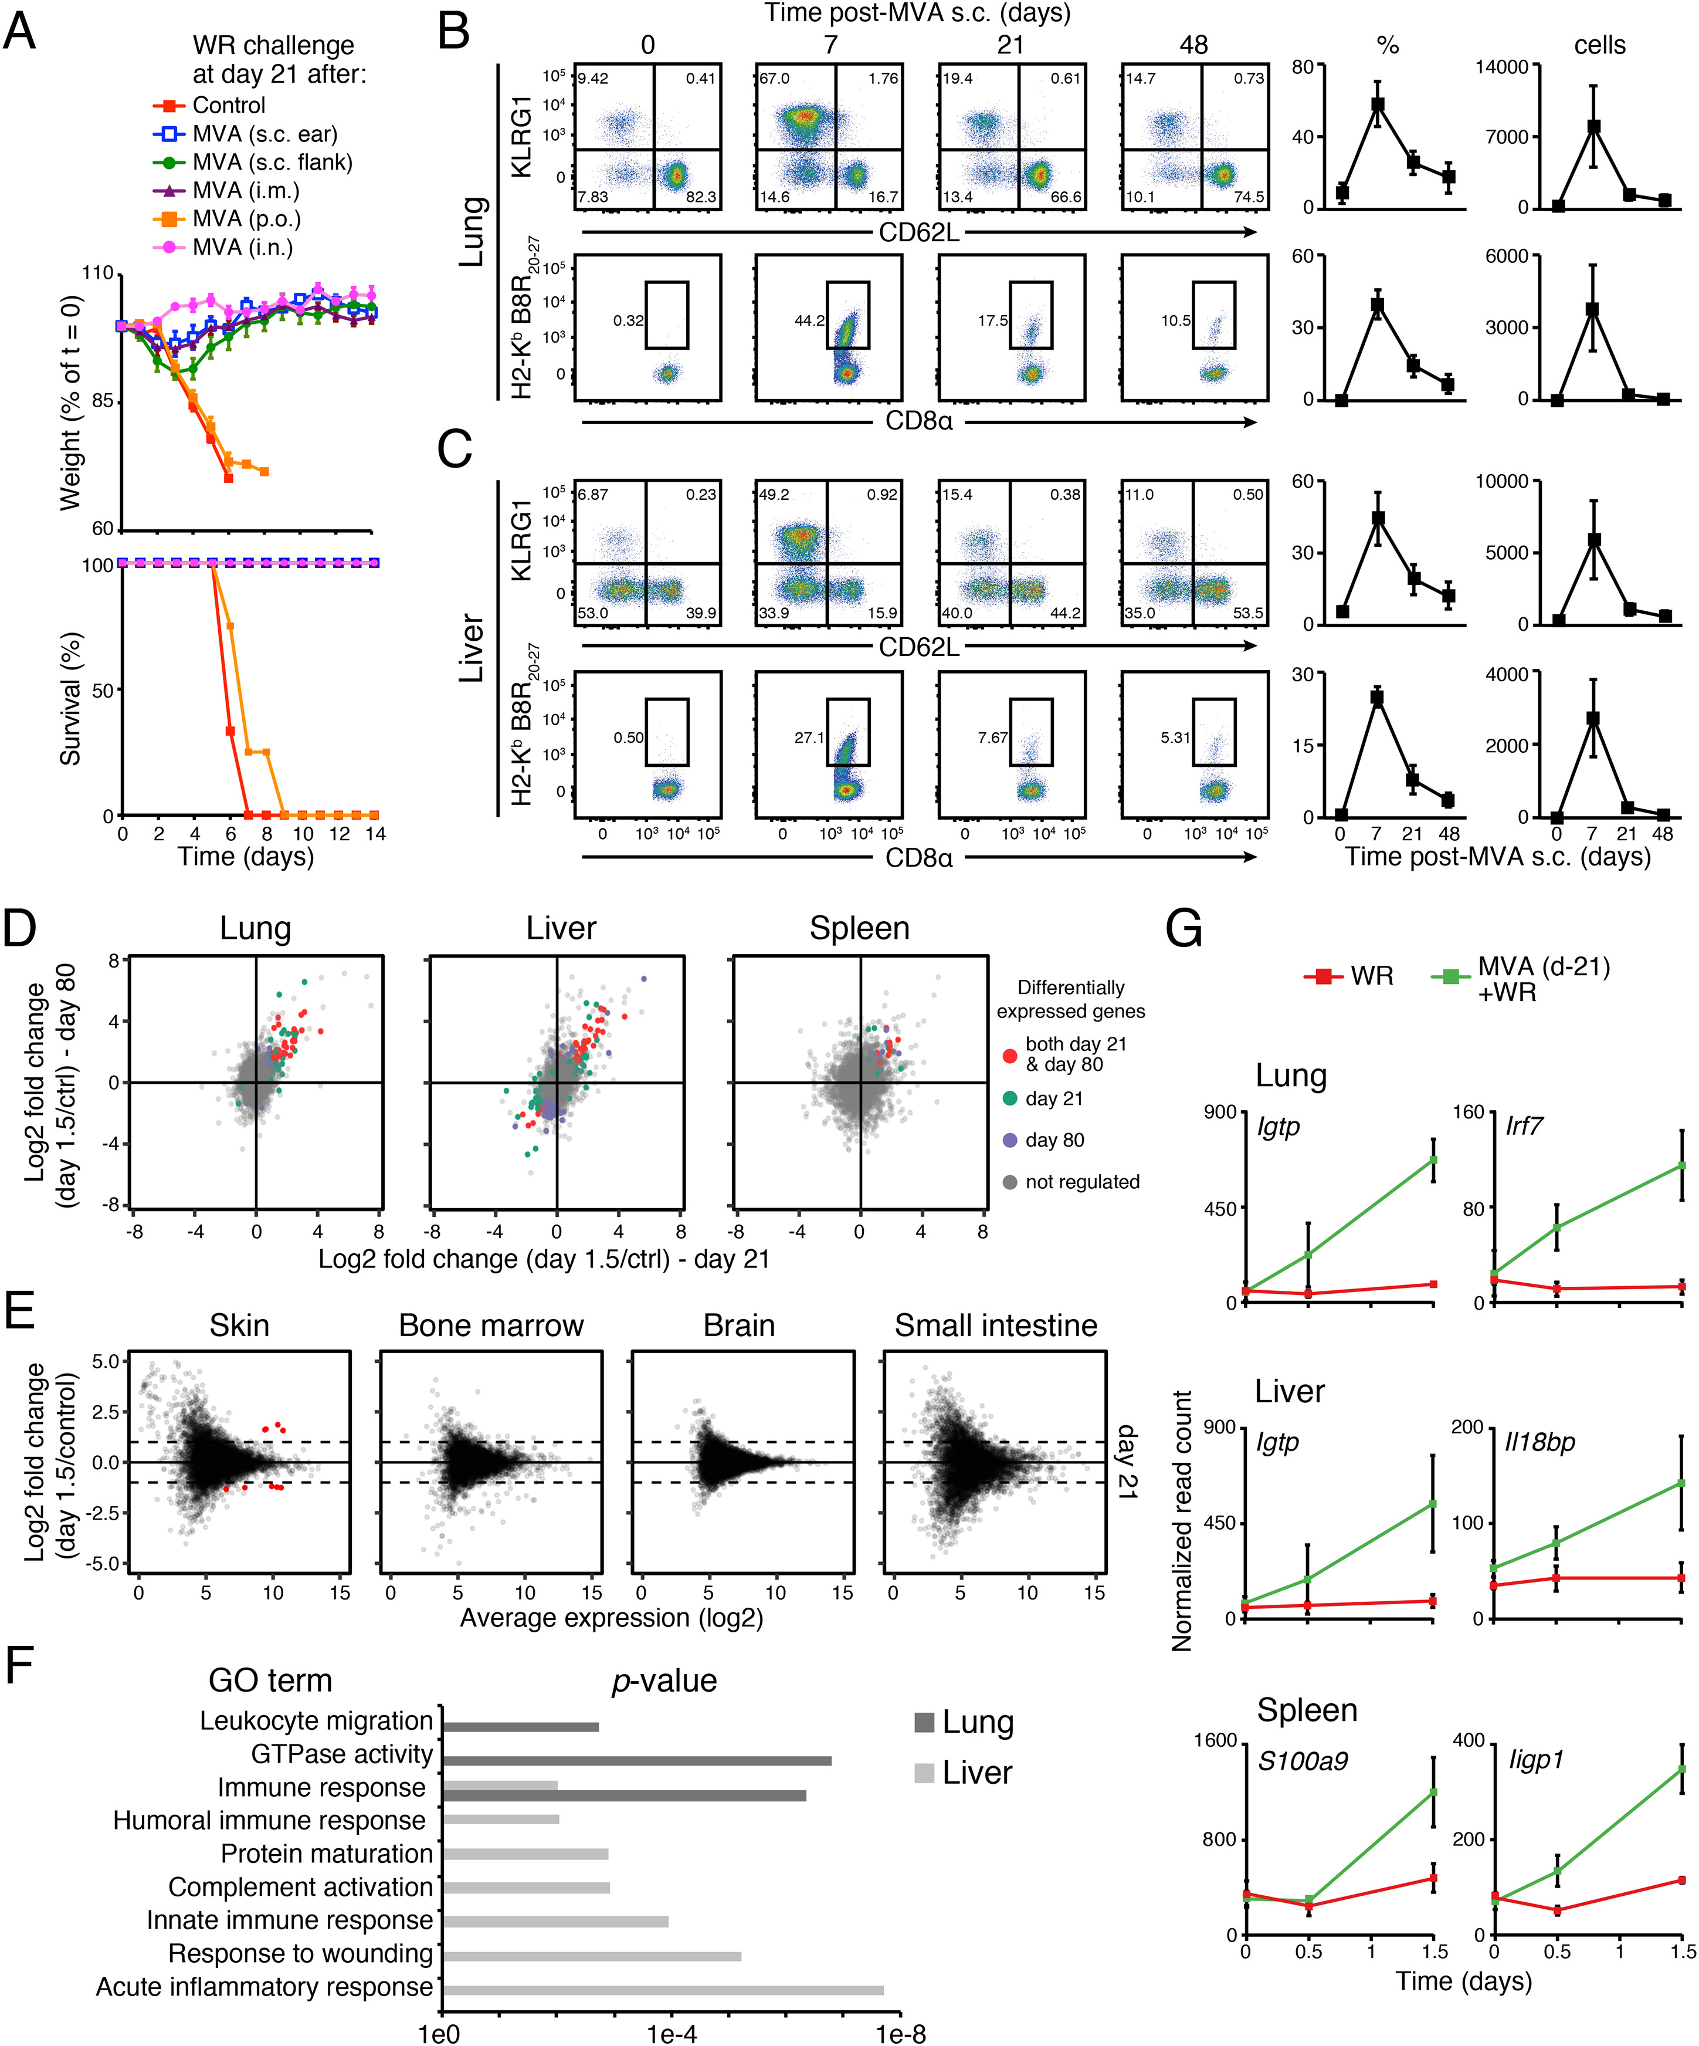
Figure S4
Cell 2017 171398-413.e21DOI: (10.1016/j.cell.2017.08.024)
Copyright © 2017 Elsevier Inc. Terms and Conditions
Notes:
Memory Responses to a Respiratory Challenge at Lung and Liver Are Limited to Lung, Liver, and Spleen, Related to Figure 4
(A) Weight (top) and survival (bottom) measurements for indicated mouse cohorts (legend). MVA vaccination routes were subcutaneous at ear or flank skin (s.c.), intra-muscular (i.m.), oral (per os; p.o.), or intranasal (i.n.). Error bars, SEM (n = 4).
(B and C) Flow cytometry analysis of the CD8⁺ T cell response to MVA vaccination at skin. Shown are dots plots (left) and matching quantifications (right) for live CD3ε⁺CD8α⁺ CD44⁺CD62L⁻ cells that are KLRG1⁺ (top), or CD62L⁻ and tetramer-positive (bottom), for lung (B) and liver (C). Numbers in dot plots indicate percentages relative to parent gate. Line graphs on the right show percentages relative to parent gate (%) and absolute cell counts per 10⁵ live cells (cells). Error bars, SD (n = 3).
(D) Dot plots showing average log2 fold change in gene expression in tissues collected at 1.5 day post-WR challenge following 21 days (x axis) or 80 days (y axis) of MVA vaccination relative to uninfected controls (n = 4). Colored dots represent genes with FDR < 0.05 and absolute log2 fold change > 1 in both day 21 and day 80 (red), day 21 only (green), and day 80 only (blue).
(E) Dot plots showing average log2 fold change in gene expression (y axis) in tissues collected at 1.5 day post-WR challenge following 21 days of MVA vaccination relative to uninfected controls against log2 average expression (x axis) (n = 4). Red dots, gene with FDR < 0.05 and absolute log2 fold change > 1.
(F) Gene enrichment analysis for differentially expressed genes in lung and liver after WR challenge 21 days post-MVA vaccination at skin. Shown are enrichment p values (x axis) for indicated Gene Ontology (GO) terms (y axis) (FDR-adjusted p value < 0.05).
(G) Line graphs for selected genes from lung, liver and spleen from indicated cohorts and tissues. Shown are average normalized read counts. Error bars, SEM (n = 4).

Slide 14
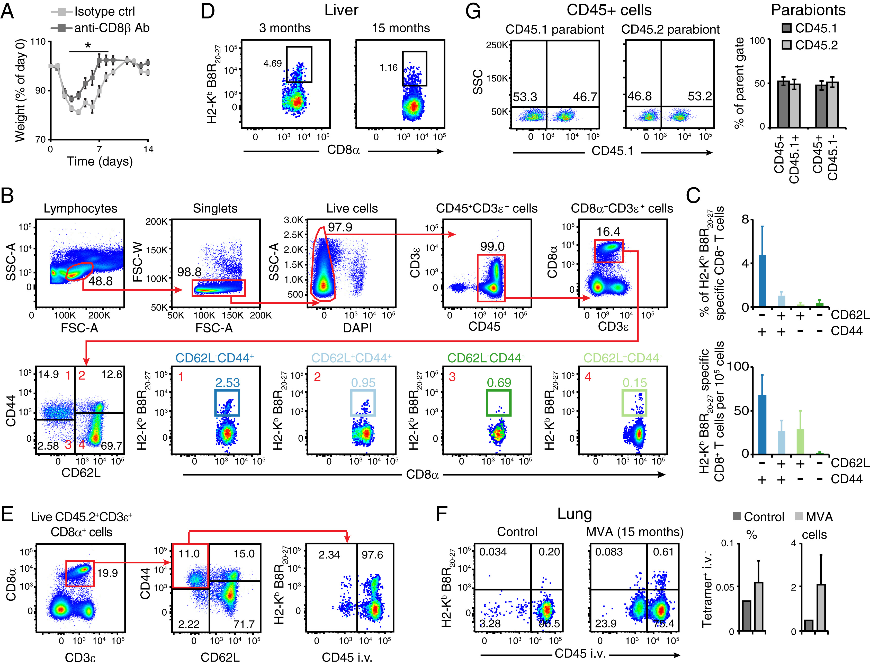
Figure S5
Cell 2017 171398-413.e21DOI: (10.1016/j.cell.2017.08.024)
Copyright © 2017 Elsevier Inc. Terms and Conditions
Notes:
Flow Cytometry Gating Strategies to Track Vaccinia-Virus-Specific Memory CD8⁺ T Cells, Related to Figure 5
(A) Weight measurements of MVA-vaccinated mice treated with isotype control (light gray) or anti-CD8β (dark gray) antibodies, and challenged with WR intranasally (2 weeks after vaccination). Error bars, SEM (n = 4). ∗; Student’s t test p value < 0.05.
(B) Gating strategy for flow cytometry analysis of memory CD8⁺ T cells. Shown are dissociated lung cells. Numbers in red in bottom plots (1–4) indicate matching gates from the CD44/CD62L gate (bottom left).
(C) Quantification of flow cytometry data from (B) for Vaccinia virus peptide B8R-specific (H2-K^{b} B8R20-27) CD8⁺ T cells in percentage of parent gates based on CD44 and CD62L expression (top) and absolute counts per 10⁵ live cells (bottom). Error bars, SD (n = 5).
(D–F) Flow cytometry analysis of Vaccinia virus peptide B8R-specific (H2-K^{b} B8R20-27) memory CD8α⁺ T cells (gated on live CD3ε⁺CD44⁺CD62L⁻ cells) from indicated tissues of mice vaccinated at skin with MVA 3 months (D, left) or 15 months (D, right, and F) earlier. In panels E and F, vascular and parenchymal cells are measured by intravascular staining with CD45 (CD45 i.v.), and bar graphs show quantifications in percentage of parent gate (%) and absolute count per 10⁵ live cells (cells). Error bars, SD (n = 3).
(G) Chimerism measurements after parabiosis surgery. Flow cytometry analysis of CD45.1⁺ and CD45.2⁺ cells in peripheral blood mononuclear cells (PBMCs) in indicated parabionts, and bar graph showing quantifications in percentage (%) of parent gate (i.e., all CD45⁺ cells). Ratio of partner-derived to endogenous blood immune cells reached 50:50 within two weeks after surgery. Error bars, SD (n = 5).

Slide 15
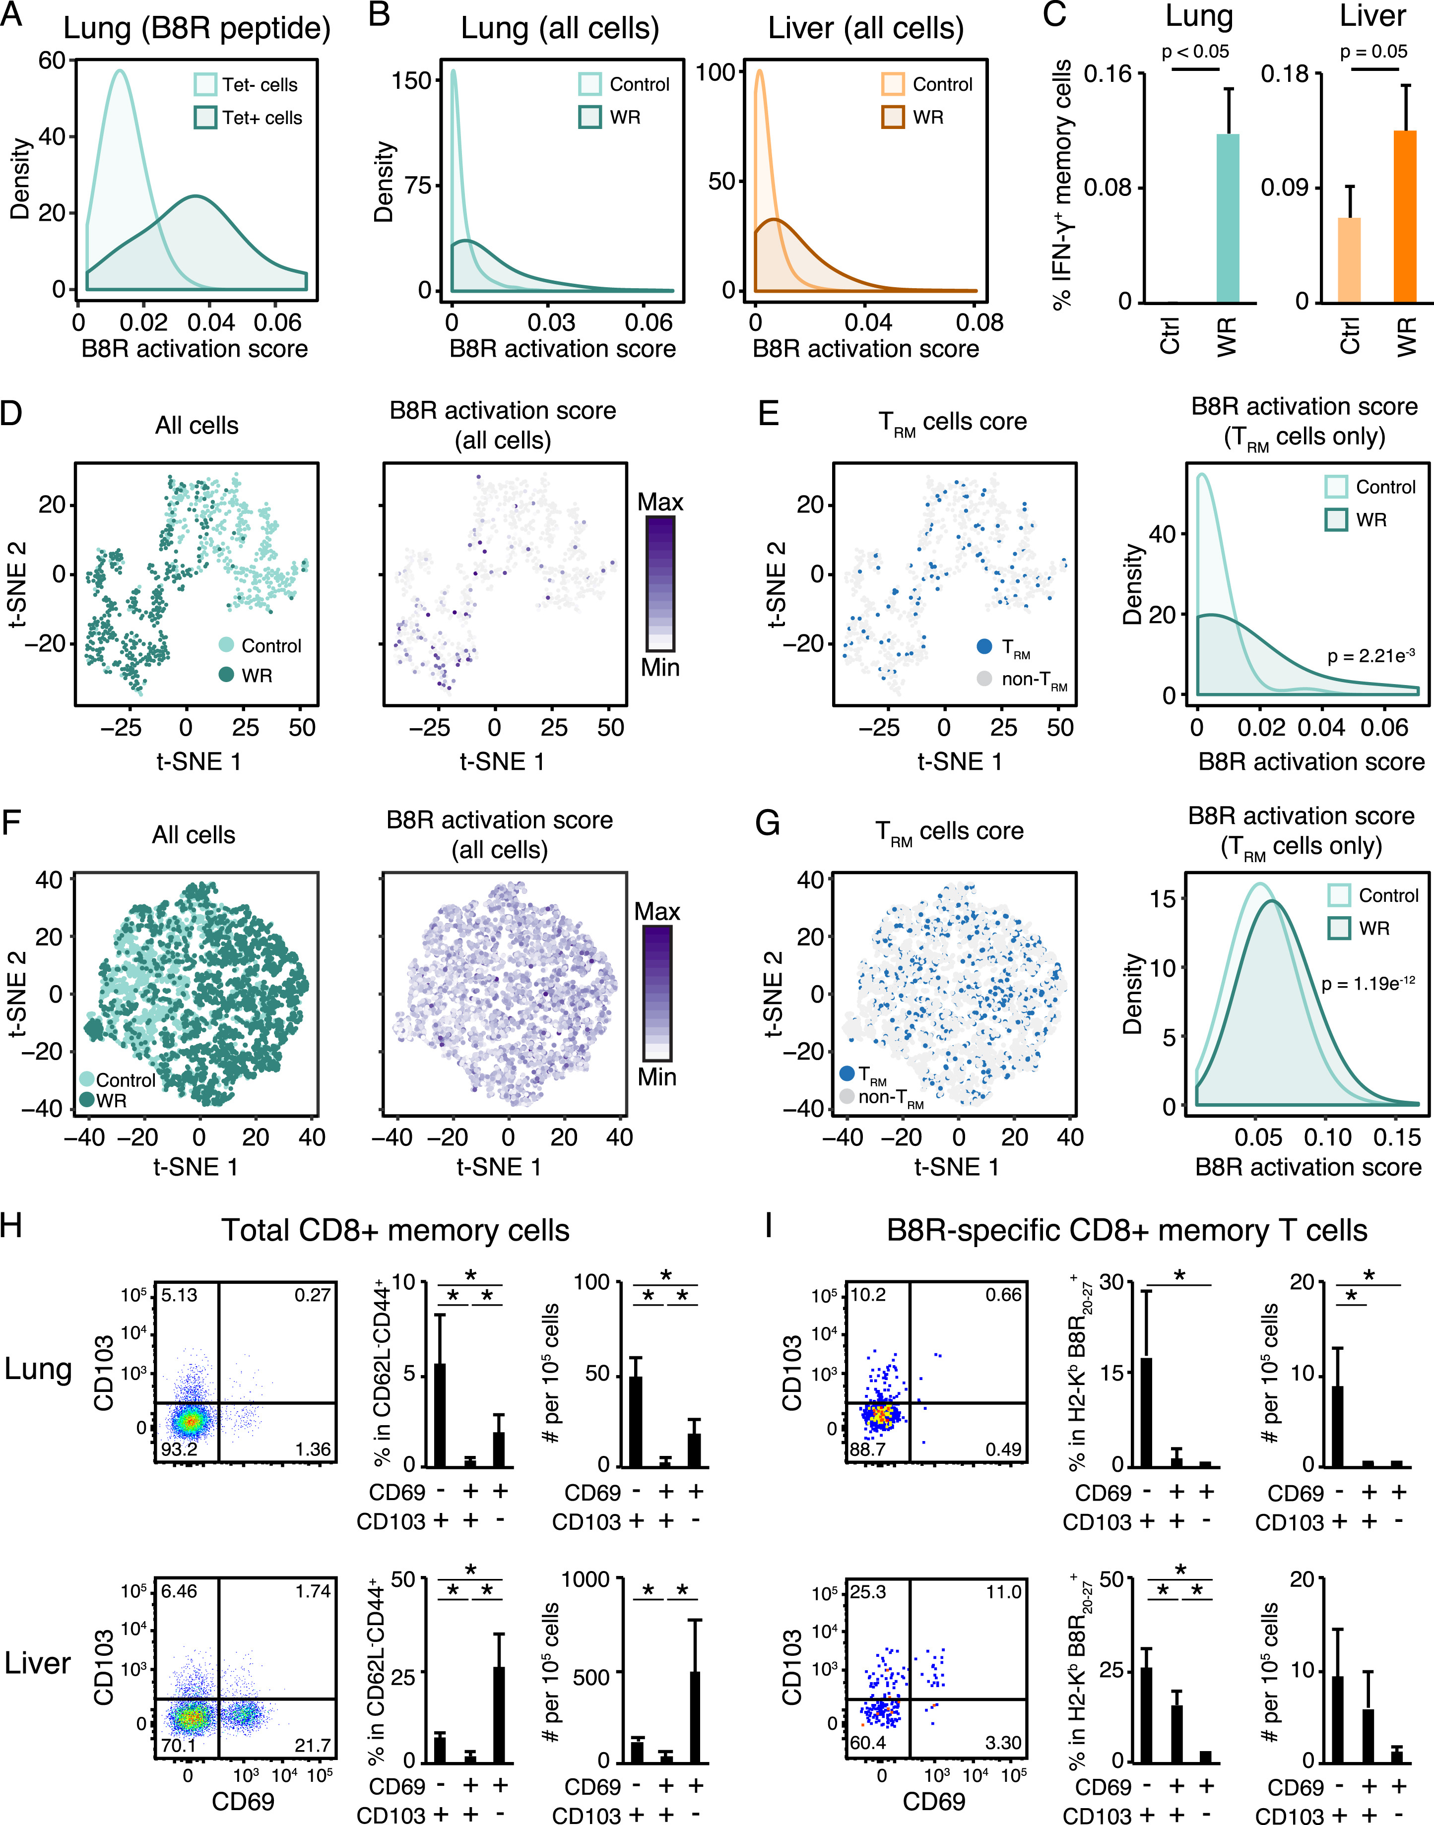
Figure S6
Cell 2017 171398-413.e21DOI: (10.1016/j.cell.2017.08.024)
Copyright © 2017 Elsevier Inc. Terms and Conditions
Notes:
Activation of Memory CD8⁺ T cells in Lung and Liver upon Intranasal Challenge with WR, Related to Figure 6
(A and B) Distributions of B8R activation scores in single cells that are tetramer-positive or -negative (Tet+/−) from mice immunized with MVA and challenged with B8R peptide (A); and from all single cells shown in Figure 6D for lung (left) and liver (right) (WR challenge; B).
(C) Flow cytometry analysis of intracellular interferon gamma (IFN-γ) protein abundance in memory CD8⁺ T cells in mice vaccinated with MVA and challenged with WR 21 days later (WR), or left unchallenged as control (Ctrl). Shown are percentages of CD3ε⁺CD44⁺CD62L⁻ cells that express IFN-γ in lung (left) and liver (right) at day 0.5 post-challenge. Error bars, SD (n = 3). p; Student’s t test p value.
(D–G) Independent validations of single-cell RNA-seq measurements from lung memory CD8⁺ T cells. 746 (D-E) and 7,292 (F-G) single cells were processed with a plate-based scRNA-seq protocol (as in Figure 6A) or a droplet-based protocol, respectively. t-SNE plots from both protocols are colored based on treatment (MVA vaccination only versus vaccination + challenge; D and F, left), B8R activation scoring (D and F, right), and TRM scoring (E and G, left). Panels on the right in E and G depict the distributions of B8R activation scores (from D and F, right) in TRM cells (from E and G, left).
(H and I) Flow cytometry analysis of TRM markers CD69 and CD103 at lung (top) and liver (bottom) on total (H) and Vaccinia virus peptide B8R-specific (I) memory CD8⁺ T cells. Matching quantifications in percentage of parent gate and absolute count per 10⁵ live cells are shown on the right of each plot. Error bars, SD (n = 4). ∗; Student’s t test p value < 0.05.

Slide 16
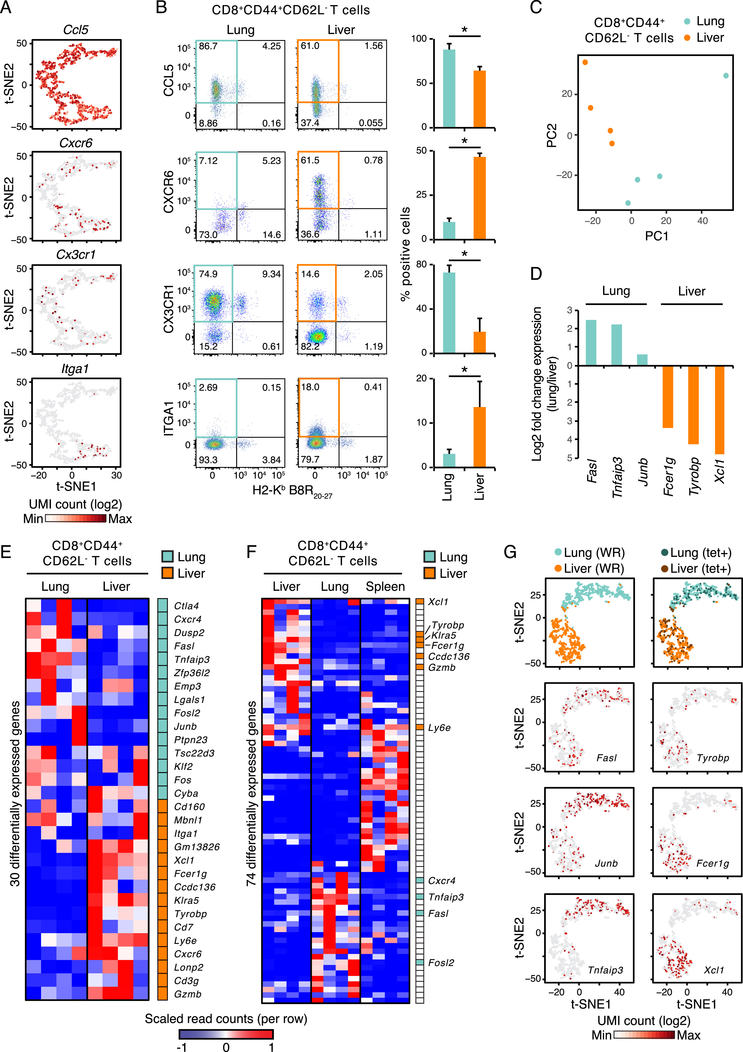
Figure S7
Cell 2017 171398-413.e21DOI: (10.1016/j.cell.2017.08.024)
Copyright © 2017 Elsevier Inc. Terms and Conditions
Notes:
Validation of Tissue-Specific Markers Identified by Single-Cell RNA-Seq Using Flow Cytometry and Bulk RNA-Seq, Related to Figure 7
(A) Expression levels of tissue-specific genes in single cells. t-SNE plot from Figure 7B colored based on expression levels (UMI, unique molecular identifiers) of indicated genes.
(B) Flow cytometry analysis of surface protein expression for all 4 markers from (A). Vaccinia virus peptide B8R-specific (H2-K^{b} B8R20-27) CD8⁺ T cells are gated on CD3ε⁺CD44⁺CD62L⁻ memory cells. Bar graphs showing quantifications in percentage from indicated gates. Error bars, SD (n = 3-5). ∗; Student’s t test p value < 0.05.
(C) Visualization of transcriptional profiles of 5,000 pooled, sorted CD44⁺CD62L⁻CD8⁺ T cells from lung and liver after MVA vaccination by principal component analysis (PCA). Axes indicate percentage (%) of variance for PC1 and 2.
(D) Expression of tissue-specific memory CD8⁺ T cell markers shown in Figure 7C in sorted lung and liver CD44⁺CD62L⁻ CD8⁺ T cells. Shown are the fold change in expression for the indicated genes between memory CD8⁺ T cells from lung and liver.
(E and F) Heatmap showing genes that are expressed in a tissue-specific manner in memory CD8⁺ T cells after s.c. MVA vaccination for 3 weeks. Shown are scaled, normalized read counts (rows) for 4 independent replicate mice (columns; n = 4). Colors on the right indicate genes found to be differentially expressed between lung (blue) and liver (orange) memory CD8⁺ T cells based on scRNA-seq measurements (from Figure 7A).
(G) Tissue-specific expression patterns in single memory CD8⁺ T cells are preserved upon WR challenge in vaccinated mice. t-SNE plots of single cells from lung (369) and liver (369) in MVA-vaccinated mice challenged with WR (top). Vaccinia virus peptide B8R-specific (H2-K^{b} B8R20-27) CD8⁺ T cells (tet+) are labeled in the top right plot for lung (94/369 cells) and liver (94/369 cells). The bottom 3 rows of plots are colored based on expression levels (UMI, unique molecular identifiers) of indicated genes.

